Slide 1
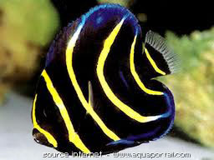



Sustainability and status of a women ornamental fishing cooperative
Author: Nathalie Germain
Presented by: Mariana Walther

Slide 2
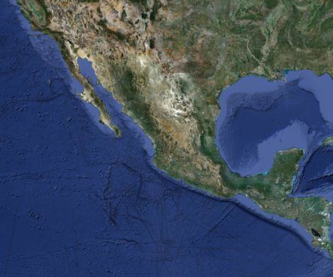
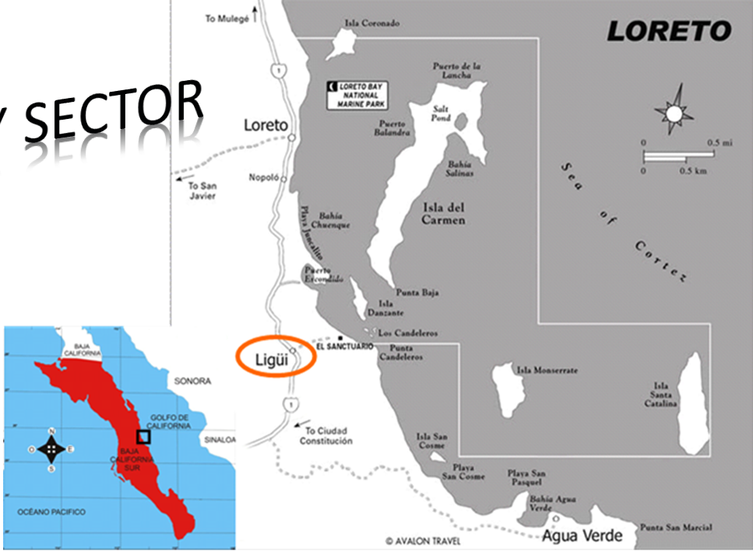
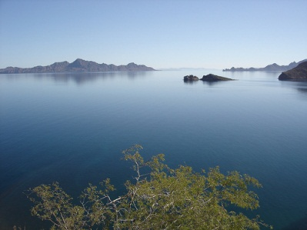
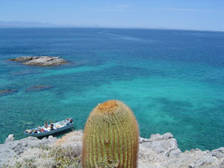
1 km
114°0’0”W
111°0’0”W
27°0’0”N
24°0’0”N
203 inhabitants in Ligüi (121 adults)
Women (Mujeres del Golfo)

Slide 3
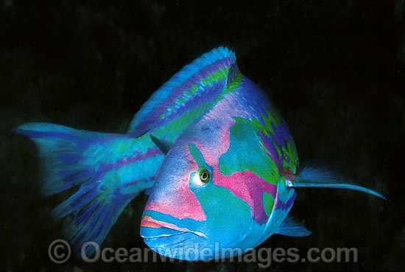
Socio-economic valuation of members of a fishing cooperative and their residential community
Surveys (Feb, Mar, Aug 2011)
Interviews
Cooperative MG (n=10)
Community of Ligüi (n=57)
Socio-economic indices
SWOT analysis of the enterprise «Mujeres del Golfo» from a participatory workshop with the members (2010).

Slide 4
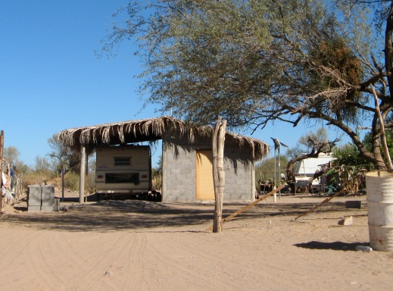
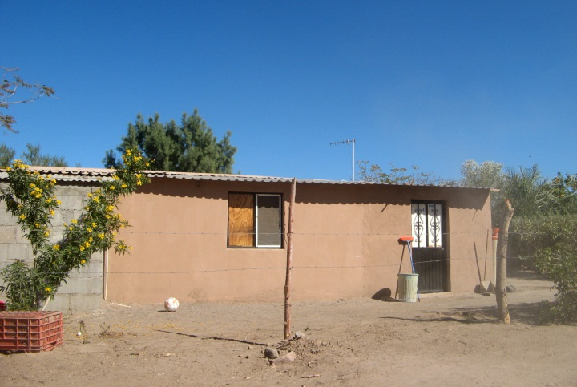
 | Mujeres del Golfo | Community of Ligüi
Walls | % | %
blocks | 40 | 81
wood | 40 | 8
Roof
lamina | 60 | 38
concrete | 10 | 42
Floor
cement | 80 | 81
 | Mujeres del Golfo | Community of Ligüi
 | % | %
Piped and drinking water | 100 | 96
NO Electricity | 30 | 74
solar | 20 | 56
Gasoline generator | 10 | 19
NO phone | 80 | 89

Slide 5
Community of Ligüi
99% of the residents were fishermen
Change in sector of activity
 |  | Mujeres del Golfo | Community of Ligüi
Economy | Other activity | % | %
 | Yes | 44.5 | 22.8
 | No | 55.5 | 75.5
Inheritance | Father was a fisherman
 | Yes | 77.8 | 45.6
 | No | 22.2 | 50,8

Slide 6
Use of socio-economic indices
To determine the level of human development of the community and the sustainability of this fishery activity
INDICES
Economic (EI)
Scholar (SI)
Environmental (EnvI)
Access to Health System (AHSI)

Slide 7
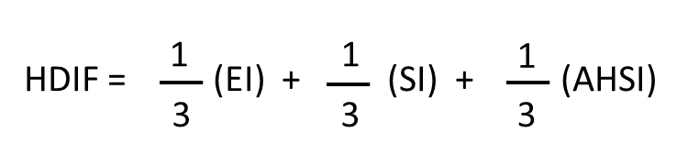

Sustainable Fisheries Development Index
Human Development Index of Fisheries
1
1
1
SFDI = (EI) + (SI) + (EnvI)
3
3
3
 | Rank | Classification
Sustainable Fisheries Development Index (SFDI) | 1 | sustainable
 |  | medium sustainability
 | 0 | not sustainable
Human Development Index of Fisheries (HDIF) | 1 | high
 |  | medium
 | 0 | low

Slide 8

Socio-economic indices
Sustainable Fisheries Development Index
Human Development Index of Fisheries
Not sustainable
Medium development
Medium sustainability
Economically
Environmental
Salary of MG very low (<50 US$/month)
Fishermen left school very early (average 15 years old )
Fishing quotas not used at the maximum granted.
AHSI high because creation Mexican health system for everyone included poorest people in 2003.

Slide 9
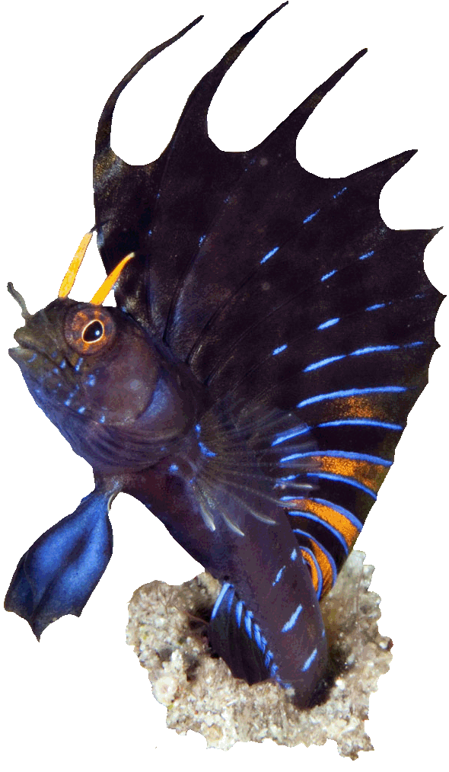
 |  | internal factors |  | Examine the strengths that can dominate the weaknesses
 |  | List of Strengths (S1, S2, S3) | list of Weaknesses (W1, W2, W3)
external factors | List of Opportunities (O1, O2, O3) | SO (Maxi-Maxi) | WO (Mini-Maxi)
 |  | Strategy to maximize both the S and O. | Strategy to minimize the W and maximize the O.
 | List of Threats (T1, T2, T3) | ST (Maxi-Mini) | WT (Mini-Mini)
 |  | Strategy to maximize the S and minimize the T. | Strategy to minimize both the W and T.
Examine the opportunities that help minimize threats
SWOT
MATRIX

Slide 10
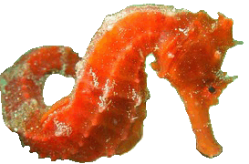
SWOT Strategies
SO (Maxi-Maxi) | WO (Mini-Maxi)
Strategy to maximize both the S and O. | Strategy to minimize the W and maximize the O.
1. Xxxxxxxxx (S1, S2, O2, O4…) | 1. Xxxxxxxxx (SW1, W3, O2, O1…)
2. Xxxxxxxx (S3, S4, O1, O4…) | 2. Xxxxxxxx (W3, W4, O1, O4…)
ST (Maxi-Mini) | WT (Mini-Mini)
Strategy to maximize the S and minimize the T. | Strategy to minimize both the W and T.
1. Xxxxxxxxx (S1, S2, T2, T4…) | 1. Xxxxxxxxx (W1, W3, T2, T4…)
2. Xxxxxxxx (S3, S4, T1, T4…) | 2. Xxxxxxxx (W3, W4, T1, T4…)
ᴥ Youth and fishermen employment - job opportunity, equitability, decrease of illegal fishing.
ᴥ Low profits and capital - increase and diversify direct purchasers.
ᴥ Strengthen their ecological knowledge and good practices of resource exploitation - share this with other residents to raise community awareness, changes in perceptions and attitudes towards nature and contribute to environmental protection.
ᴥ Support and intervention strategic alliances - to reduce or mitigate corruption, unfair competition, illegal market and lack of government oversight.

Slide 11





